Slide 1


2020-2021
Web Fundamentals
checkpoint
JDAY Intissar

Slide 2

PLAN
History
Web developer role
Conclusion
The web
Web developer skills
Introduction

Slide 3

History
Sir Timothy John Berners-Lee, born 8 June 1955, also known as TimBL, is an English computer scientist best known as the inventor of the World Wide Web.
In 1989 the world wide web was invented by Sir Tim Berners-Lee. He was trying to find a new way for scientists to easily share the data from their experiments.
Hypertext and the internet already existed at this point but no one had thought of a way to use the internet to link one document directly to another.

Slide 4
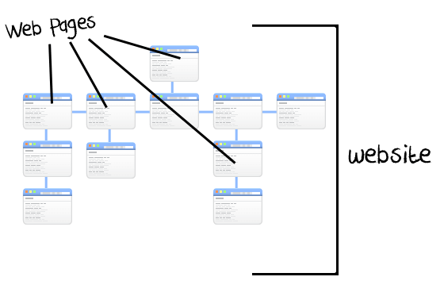


Introduction
The internet is a huge network of computers all connected together.
The world wide web (‘www’ or ‘web’ for short) is a collection of web pages found on this network of computers.

Slide 5


The web
Web page is just code. The code is HTML, XML, CSS, and Javascripting. This code is then interpreted by your browser and then displayed (text, images or other resources). It is because of this reason that different browsers interpret websites differently.
The Web is just one of the ways that information is shared over the Internet, others include email, instant messaging and File Transfer Protocol (FTP).

Slide 6
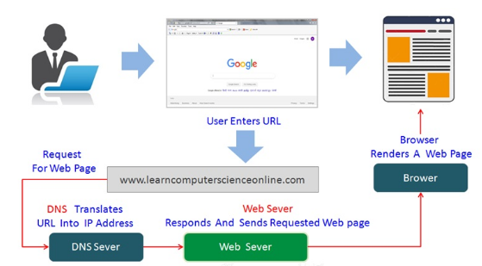
The web
How does the web works ?
1
7
browser
Client
6
2
3
4
5

Slide 7
The web
In short :
A user enters a URL into a browser exp (https://gomycode.tn into chrome) this request is passed to a domain name server (DNS).
DNS returns an IP address for the server that hosts the website exp (194.199.8.10)
The browser requests the page from the web server using the IP address specified by the DNS.
The web server returns the page to the IP address specified by the browser requesting the page.
The browser collects all the information and displays to your computer in the form of web page.

Slide 8
Web developer skills
Every website you see probably had a Web Developer behind it somewhere. It’s important for Web Developers to be more than just computer programmers. So a Web Developer should have several skills that encompass both computers and people, including:
Technical knowledge in areas such as client-side components, server-side languages, web application frameworks and database management systems.
Experience with version control systems, and a thorough understanding of the architecture of web applications and web security and encryption
Attention to details.
A logical approach to problem solving.
The ability to work independently and in mixed teams.
Experience of development methodologies (such as Agile and Waterfall).
The ability to manage a complex range of tasks and meet deadlines.
Good communication skills.

Slide 9
Web developer skills
Web developer role
write code in one or more programming or scripting languages, such as PHP or JavaScript
plan and prototype new applications
design the architecture of the components of an application
decide on the best technologies and languages for the project
test sites and applications in different browsers and environments
problem-solve
fix bugs in existing projects
test new features thoroughly to ensure they perform the correct task in all cases run performance benchmarking tests

Slide 10
Web developer role
build and test Application Program Interfaces (APIs) for applications to exchange data
meet designers, developers and project staff for progress updates
gather requirements from clients and users
learn and test new technologies, frameworks and languages
stay up to date with new trends and advancements in web development
build and maintain databases
carry out code refactoring and optimization of existing code
document code, so other developers can understand and contribute to it

Slide 11
Conclusion
the web is so important!
The world wide web opened up the internet to everyone, not just scientists. It connected the world in a way that was not possible before and made it much easier for people to get information, share and communicate. It allowed people to share their work and thoughts through social networking sites, blogs and video sharing.

